Slide 1
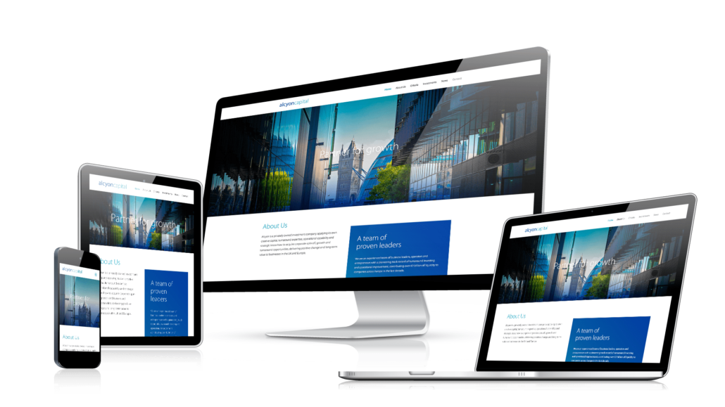
Media Queries
Responsive Web Design
SoftUni Team
Technical Trainers
Software University
https://softuni.bg

Slide 2
Table of Contents
Responsive Web Design
Media Queries
Media Types
Media Feature Rules
Media Queries Conditions
Notes:
2

Slide 3
Have a Question?
sli.do
#html-css
Notes:
3

Slide 4

Resize, Hide, Shrink, or Enlarge A website to Make It Look Good On All Devices

Slide 5
What is Responsive Web Design?
Automatically resize, hide, shrink, or enlarge, a website, to make it look good on all devices (desktops, tablets, and phones)
Setting the Viewport:
Add the following <meta> element:
This will give the browser instructions on how to control the page's dimensions and scaling
<meta name="viewport" content="width=device-width, initial-scale=1.0">
5

Slide 6
Components of Responsive Design
Responsive website design consists of the following three main components:
Flexible layouts
Using a flexible grid to create the website layout
That will dynamically resize to any width
Media queries
Allow designers to specify different styles for specific browser and device circumstances

Slide 7
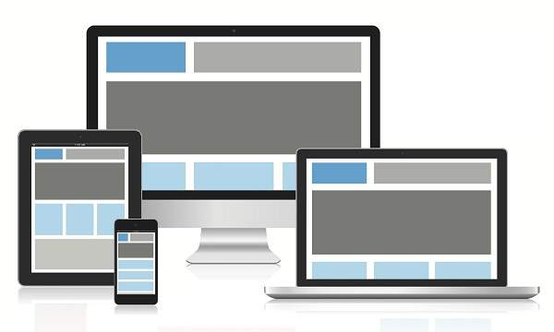
Components of Responsive Design
Flexible Media
Makes media (images, video and other format) scalable

Slide 8

Benefits of Using a Responsive Website
Increased traffic from mobile users
Lower cost and website maintenance
Provides a seamless User Experience (UI)
Adapts easily to any screen size
Improves your SEO efforts

Slide 9
Why Responsive Website Design Works?
Google prioritizes responsive websites
73% of total eCommerce revenue comes from mobile
94% of people judges websites on responsive web design
Almost 63% of all Internet access is done through the phone
85% of adults own a smart phone
First impressions are 94% design-related
85% of people want Mobile-Friendly websites
Responsive design integrates social media

Slide 10

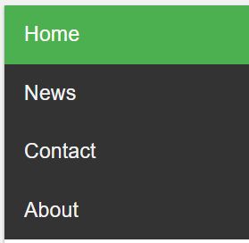
What is a Media Query?
Media Queries are a feature of CSS that enable webpage content to adapt to different screen sizes and resolutions
They are a fundamental part of responsive web design and are used to customize the appearance of websites for multiple devices
10

Slide 11
Media Query Syntax
A media query consists of a media type and can contain one or more expressions, which resolve to either true or false
The result of the query is true if the specified media type matches the type of device the document is being displayed on
Unless you use the not or only operators, the media type is optional, and the all type will be implied
@media (max-width: 600px) {
.menu a { display: block }
}
if (width <= 600px), apply these CSS rules

Slide 12
Media Query Syntax
A media type, which tells the browser what kind of media this code is for (e.g. print, or screen)
A media feature rule - test that must be passed for the contained CSS to be applied
A set of CSS rules that will be applied if the test passes and the media type is correct

Slide 13
Media Queries
Media queries in CSS3 look at the capability of the device
Media queries can be used to check many things, such as:
width and height of the viewport
width and height of the device
orientation (is the tablet/phone in landscape or portrait mode?)
resolution

Slide 14
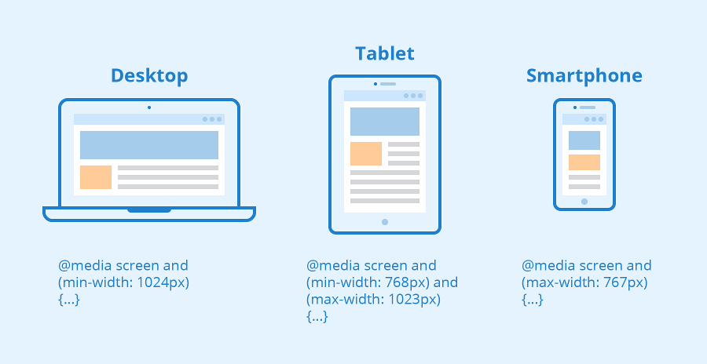
Introduction to Media Types

Slide 15
CSS Media Types
Media Types describe the general category of a given device:
all - used for all media type devices
print - used for printers
screen - used for computer screens, tablets, smart-phones etc.

Slide 16
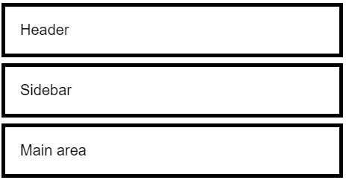
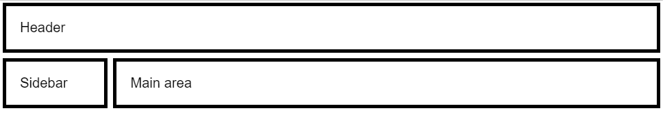
Media Queries + CSS Grid – Example
.container {
grid-template-areas:
"header"
"sidebar"
"main";
}
@media (min-width: 600px) {
.container {
grid-template-areas:
"header header"
"sidebar main";
}
}
Width < 600px
Width >= 600px

Slide 17
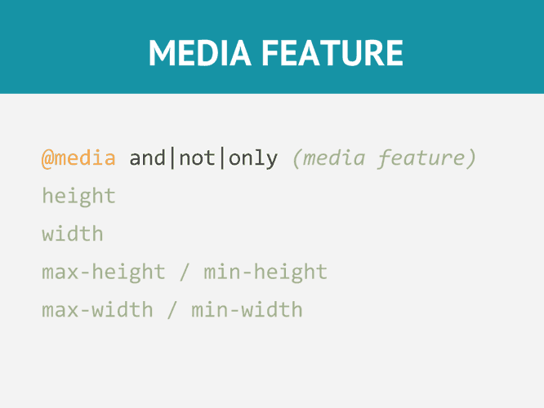
Rule Used In media queries to Apply Different Styles for Different media types/devices

Slide 18
Media Feature Rules
After specifying the type, you can then target a media feature with a rule
Width and height - we can apply CSS if the viewport is above or below a certain width, using width
@media screen and (width: 600px) {
body {
color: red;
}
}

Slide 19
Media Feature Rules
We can apply CSS if the viewport is under or above an exact width - using min-width, max-width
@media screen and (max-width: 400px) {
body {
color: blue;
}
}

Slide 20
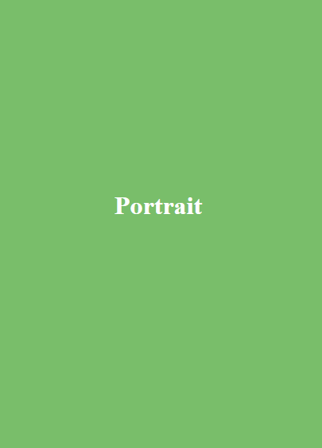

Media Feature Rules
Orientation - allows to test for portrait or landscape mode
Landscape – when window is wider than its height
Portrait – when window is higher than its wide
@media (orientation: portrait) {
.portrait { display: block; }
.landscape { display: none; }
}

Slide 21
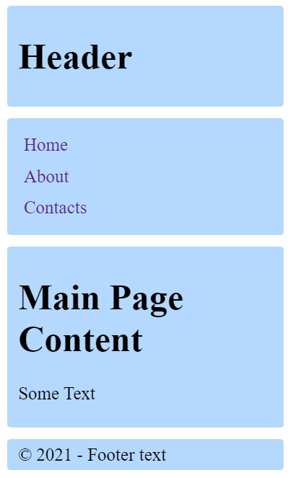
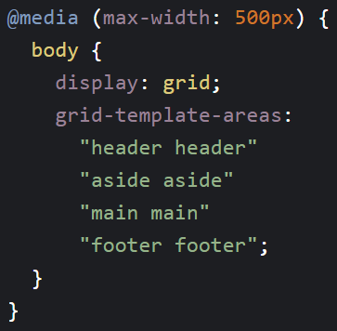
CSS Grid Responsive Layout

Slide 22
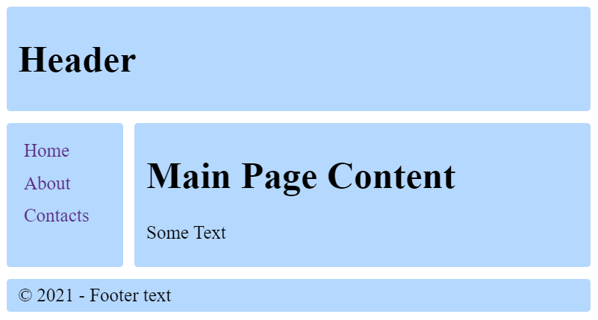
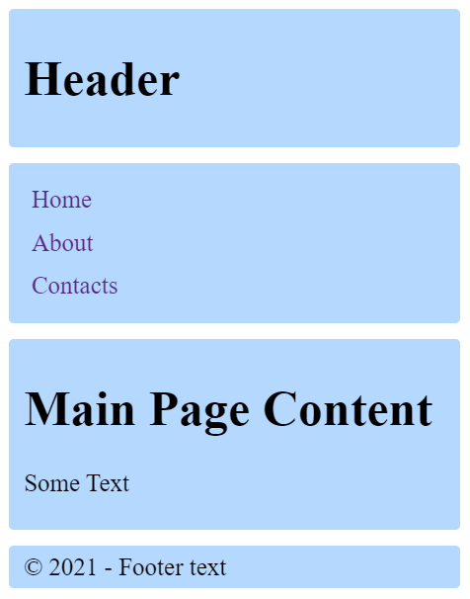
Demo: CSS Grid Site Layout
https://codepen.io/snakov/pen/MWbxZOy

Slide 23



Media Queries Conditions

Slide 24
Logical Operators: and | or
@media (min-width: 600px) and (max-width: 900px) {
.example {
/* Styles! */
}
}
Screen width between 600px and 900px
@media (max-width: 900px), (min-width: 1100px) {
.example {
/* Styles! */
}
}
OR

Slide 25
CSS @Import Rule
@import

Slide 26

Summary
What is Responsive Web Design?
What are Media Queries?
Media Types
Media Feature Rules
Notes:
26

Slide 27
Questions?
Notes:
27

Slide 28














SoftUni Diamond Partners

Slide 29

Educational Partners

Slide 30

License
This course (slides, examples, demos, exercises, homework, documents, videos and other assets) is copyrighted content
Unauthorized copy, reproduction or use is illegal
© SoftUni – https://about.softuni.bg/
© Software University – https://softuni.bg
Notes:
30

Slide 31
Trainings @ Software University (SoftUni)
Software University – High-Quality Education, Profession and Job for Software Developers
softuni.bg, about.softuni.bg
Software University Foundation
softuni.foundation
Software University @ Facebook
facebook.com/SoftwareUniversity
Software University Forums
forum.softuni.bg
31
Notes:
31

